Slide 1


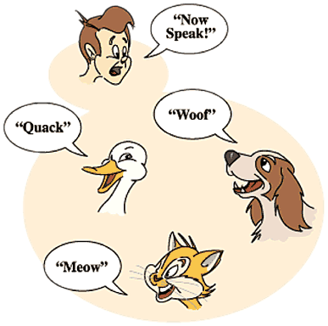

Polymorphism
Abstract Classes, Abstract Methods, Override Methods
C# OOP
Basics
SoftUni Team
Technical Trainers
Software University
http://softuni.bg

Slide 2

Table of Contents
Polymorphism
Abstract Classes
Abstract Methods
Override Methods

Slide 3
Questions
sli.do #2994

Slide 4
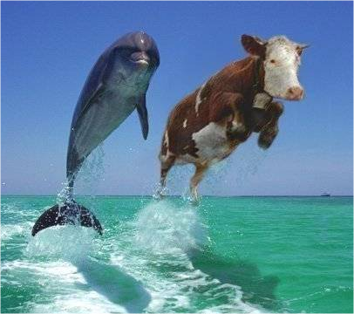
Polymorphism

Slide 5
Polymorphism
Polymorphism is the ability
to take on many forms
Notes:
Polymorphism is the ability of an object to take on many forms. The most common use of polymorphism in OOP occurs when a parent class reference is used to refer to a child class object.

Slide 6
Polymorphism Usage
A child class may override (change)
some of the parent's methods

Slide 7
Polymorphism Usage - Example
abstract class Animal {}
class Deer : Animal {}
class Elephant : Animal {}

Slide 8
Polymorphism Usage – Example(2)
Creating instance of Deer as Animal
Animal babyDeer = new Deer();
Animal babyElephant = new Elephant();

Slide 9
Why Polymorphism
To mix different data types in the same collection
Notes:
Demo (look at View -> Notes Page)
public static void Main()
{
Animal babyDeer = new Deer();
Animal babyElephant = new Elephant();
List<Animal> animals = new List<Animal>();
animals.add(babyDeer);
animals.add(babyElephant);
}

Slide 10


Why Polymorphism
void Call(Deer deer)
{…}
void Call(Elephant elephant)
{…}
void Call(Animal animal)
{…}
Notes:
Instead of making method that receive every type of animal we can create 1 method that receive their base class as parameter. To avoid code duplication

Slide 11
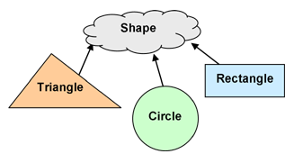
Abstract Classes

Slide 12
Abstract Classes
Abstract classes cannot be instantiated
Notes:
But they can be subclasses.

Slide 13
Abstract Classes (2)
An abstract class may or may not
include abstract methods.

Slide 14
Abstract Methods
public abstract class GraphicObject
{
abstract void Draw();
}

Slide 15
Abstract Classes - Purpose
They function as base classes
which can be extended

Slide 16
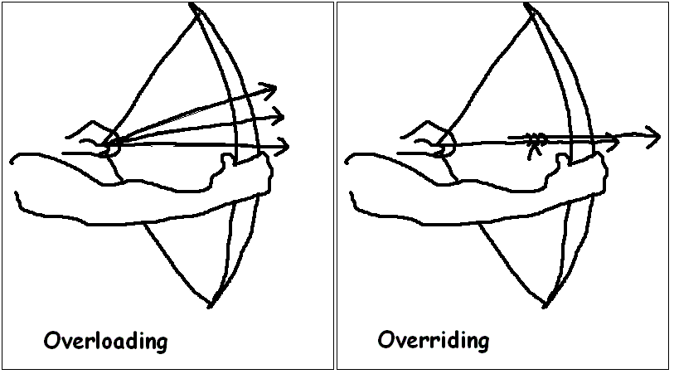
Override Virtual Methods
Notes:
The ability of a subclass to override a method allows a class to inherit from a superclass whose behavior is “close enough” and then to modify behavior as needed.

Slide 17
Overriding Virtual Methods - Rules
Using virtual keyword in parent class
for methods and properties
Notes:
In C# a method cannot be overridden in the child classes if its not declared with the keyword virtual

Slide 18
Overriding Virtual Methods – Rules (2)
The argument list should be exactly the same
as that of the overridden method.

Slide 19
Overriding Virutal Methods – Rules (3)
The access level cannot be more restrictive
than
the overridden method's access level.

Slide 20

Summary
Polymorphism allows working with objects through their parent interface and invoke abstract actions
Abstract classes cannot be instantiated
Abstract methods must be overridden in child classes
Overriding virtual methods might be overridden in child classes
Notes:
- Polymorphism allows working with objects through their parent interface and invoke abstract actions
- Abstract classes cannot be instantiated
- Abstract methods have no implementation in base class and must be overridden in the child classes
- Overriding virtual methods have implementation in the base class and may be overridden in child classes

Slide 21








Polymorphism
https://softuni.bg/csharp-basics-oop

Slide 22

License
This course (slides, examples, demos, videos, homework, etc.) is licensed under the "Creative Commons Attribution-NonCommercial-ShareAlike 4.0 International" license
Attribution: this work may contain portions from
"Fundamentals of Computer Programming with C#" book by Svetlin Nakov & Co. under CC-BY-SA license
"C# Part I" course by Telerik Academy under CC-BY-NC-SA license

Slide 23






Free Trainings @ Software University
Software University Foundation – softuni.org
Software University – High-Quality Education, Profession and Job for Software Developers
softuni.bg
Software University @ Facebook
facebook.com/SoftwareUniversity
Software University @ YouTube
youtube.com/SoftwareUniversity
Software University Forums – forum.softuni.bg

